Slide 2
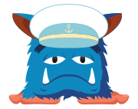
What is Stress?
Body's reaction to feeling threatened or under pressure
It can be motivating in short bursts, but it can be unhelpful when we experience if for longer periods of time
It could be:
Lots of problems at once
Certain situations or events that make us feel under pressure
Our reaction to being placed under pressure
Why might we experience test stress?

Slide 3
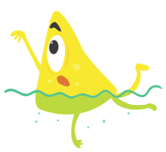
Tests
Tests are something that we experience frequently throughout our lives
They usually measure our knowledge, skills and confidence
Can you think of any tests you may experience
througout your life?
Why might we experience test stress?

Slide 4
Why might we experience test stress?
Don't have much spare time to study
They want to do really well
Feel they need to compete with others
Worries they might fail
Have other things happening in their life
Feel pressure from those around them to get good marks
Feeling unprepared

Slide 5
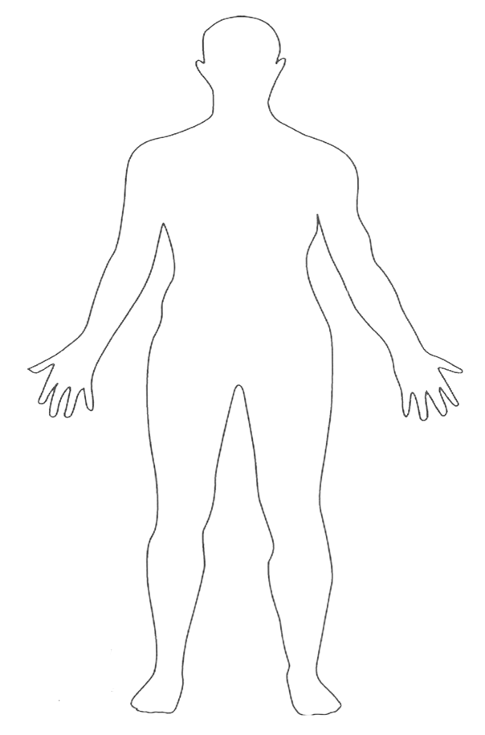
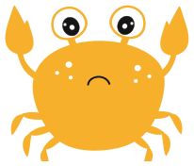
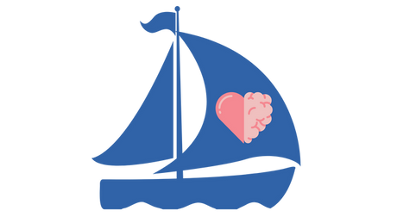
How do I know when I'm feeling stressed?
Head hurts
Feeling hot and sweaty
Fast heartbeat
Feeling confused and overwhelmed
Feeling unprepared
Quick breathing
Tense muscles and headache
Flutters in tummy
Trouble sleeping
Jelly legs
Biting nails, picking skin, fidgeting
Feel sick
Needing the toilet
Losing touch with friends

Slide 6
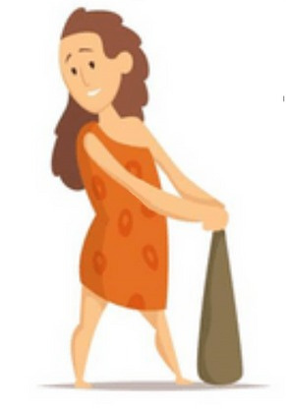
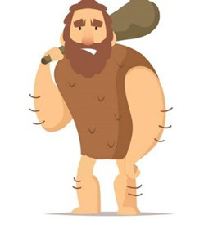
Fight, flight, freeze
Our brain has a Fight, Flight or Freeze response. This may be triggered when we are feeling worried or anxious about something.
FLIGHT
FIGHT
FREEZE
Think back to cave men times, they would have to run away from sabre tooth tigers and hunt for their food.
It is normal for everyone to act in different ways!

Slide 7
Managing physical sensations
Bee breathing
Rainbow breathing
Bubble breathing
Practise these when you are calm so you can get used to them

Slide 8
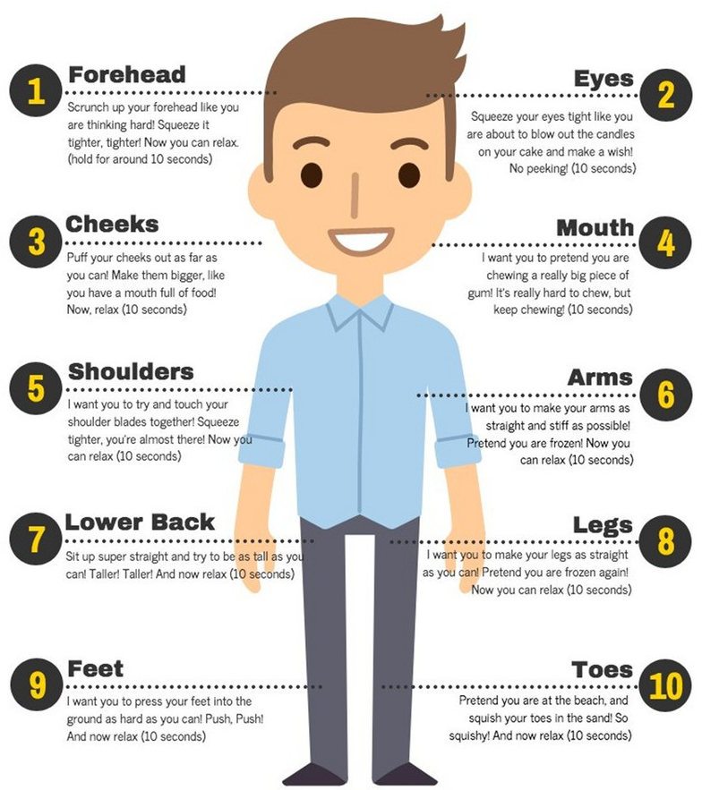
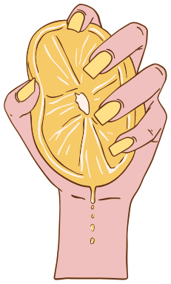
Progressive muscle relaxation
Squeeze the lemon

Slide 9
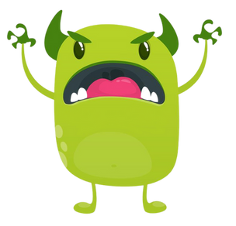
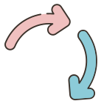
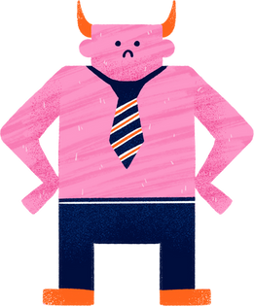
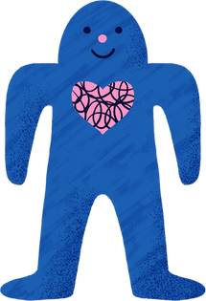
Automatic Negative Thoughts
Everyone can sometimes get thoughts that aren't very helpful. Our brains can bully us with thoughts that make us feel upset, down, worried and less confident or not believe in ourselves. Over time, these thoughts can become automatic and ANTS take over.
Brain Bully
Brain Bestie
Think
I am good enough. I'm as good as anyone else. I am kind and caring.
Think
I’m not good enough. No one likes me. Other people are better than me.
Feel
Sad, worried, disappointed, worthless
Behave
Try my best, spend time with friends
Behave
Not attempt work. Avoid other people.
Feel
Motivated, proud, happy, confident

Slide 10
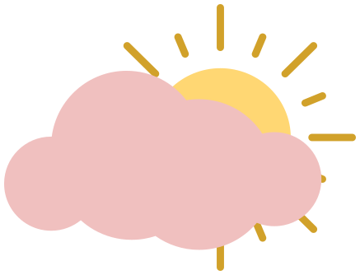
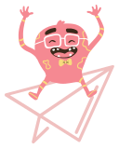
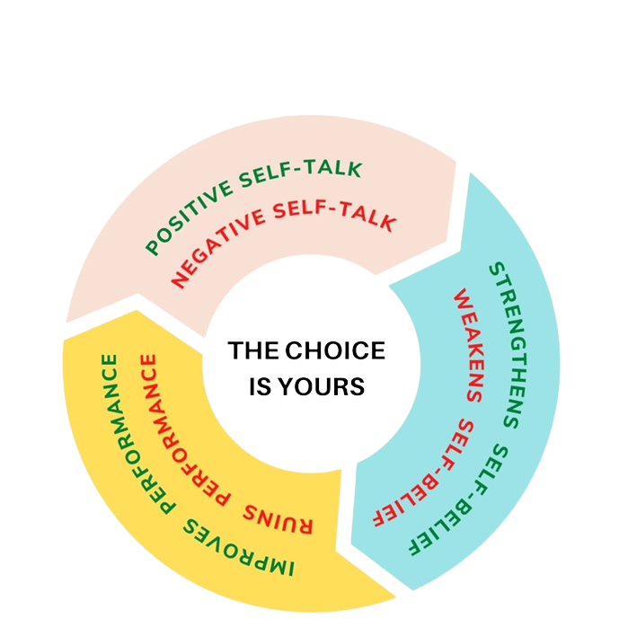
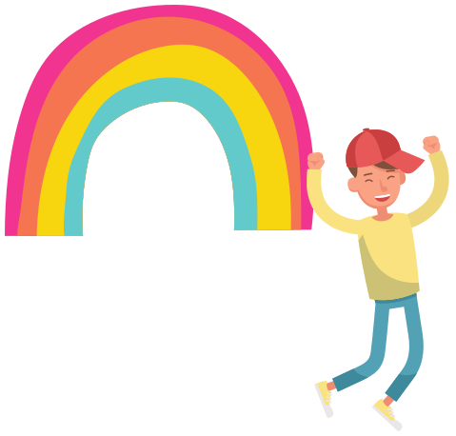
It is a good idea to keep your affirmations somewhere visible so that they begin to override any negative thoughts you might have about yourself.
Positive self talk
A positive affirmation is a statement or a thought about ourselves that we can use to make us feel good about ourselves.
Positive affirmations
are most effective
when repeated
regularly

Slide 11
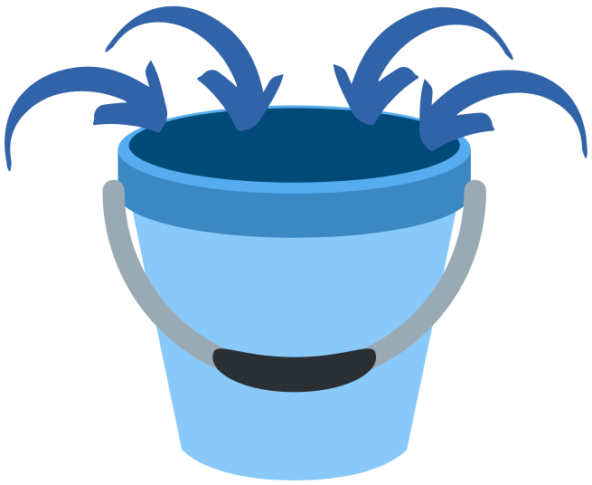
We all have a stress bucket up in our heads. When it gets too full, we can begin to feel overwhelmed
Stress bucket
Not sleeping well
Stress at home
Worry about tests
Friendship struggles

Slide 12
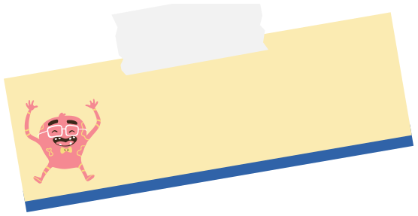
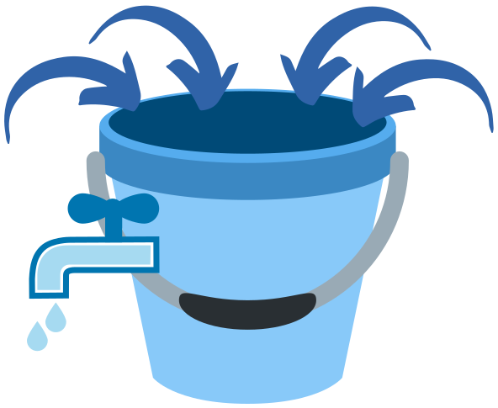
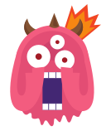
Relieving our stress
We can introduce 'taps' to our stress bucket, which will help reduce our stress and ultimately, can help us feel calmer
Not sleeping well
Stress at home
These taps can be the coping strategies you learn today
Worry about tests
Friendship struggles
Is there anything you do now that makes you feel calm?

