Slide 2
Preparing for SATs
How might people feel about SATs or tests?

Slide 3
What worries might people have about SATs or tests?

Slide 4
Teachers have told us...
Going to my chosen secondary school
Pressure to do well
When we worry, our body can react in different ways. It's very common to feel worry for short bursts and this can help us to be motivated and achieve things in our daily life such as at school or home.
Worry can become unhelpful to
us if we experience it for longer periods of time and it might affect our health and wellbeing.
Not feeling ready
Wanting to do as well as my friends
Finding tests hard
Worried about the results I will get
Other things happening in my life

Slide 5
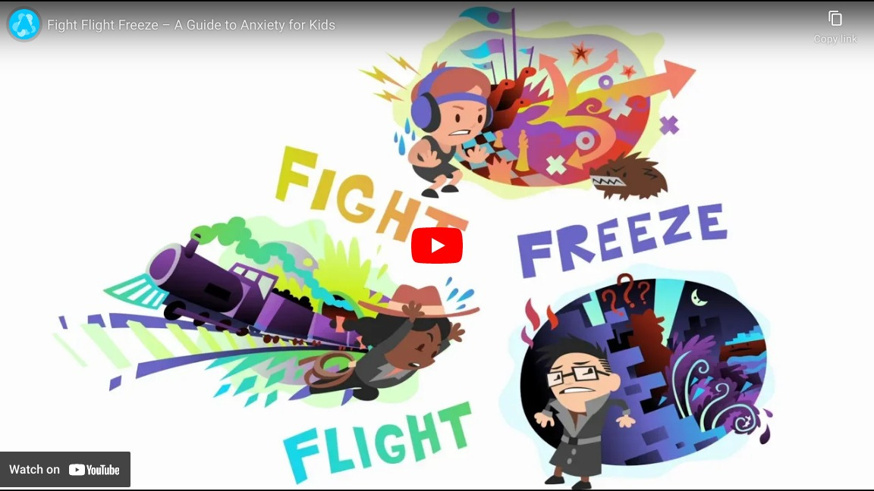
What worry can look like...

Slide 6
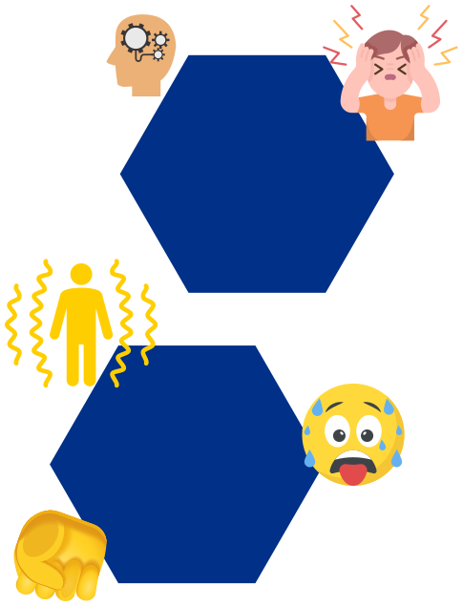
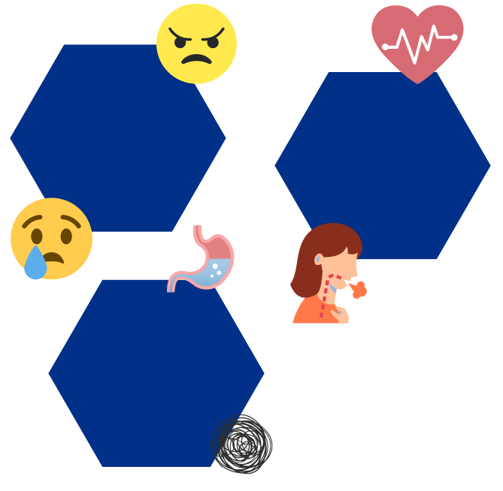
How Can Worry make my body feel?
HEAD & FACE
DIFFERENT EMOTIONS
Headache Tired
Feel dizzy Dry mouth Difficulty swallowing Go red
CHEST & HEART
Feeling angry or fustrated Feeling tearful crying
Shortness of breath or faster breathing
heart beating faster
ARMS & LEGS
STOMACH
Sweaty palms
Tense or achy muscles
Shaky legs
Pins & needles
Funny feeling in your tummy Feeling sick Change in appetite

Slide 7
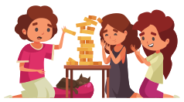
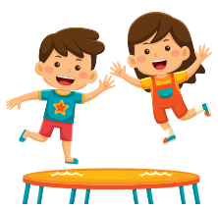
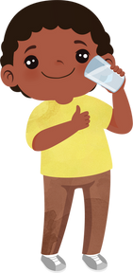
Before SATs...
Eat Healthy
Do things you enjoy
Get some sleep
Drink lots of water
Keep Active
Looking after yourself is important

Slide 8
Managing SATs Worries
What's your learning style?
Set achievable goals
Rewards
Time management
Stay on task and focus
Revision Tips
Know what works for you

Slide 9
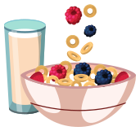
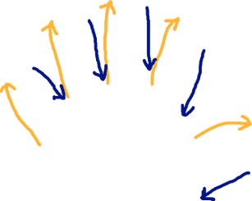
During SATs
Have a good breakfast
Notice how you feel
Positive thoughts
Use our tips to help
Do your best
Out
Be prepared and do your best

Slide 10
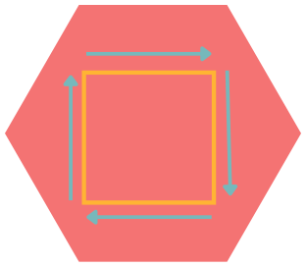
Things that can help-
Breathing and Grounding Exercises
finger breathing
happy place
In
Breathe in 1,2,3,4
Pause for 4
Pause for 4
Square Breathing
Breathe out 1,2,3,4

Slide 11
Things that can help-
Positive Self Talk
Being a good friend to ourselves is really important.
What positive things can you say to yourself?

Slide 12
After SATs
Notice the worry
Worry Tree
Log your worry
write it down, draw it or put it in your phone
Let go and have some
FUN!
Worry time
what type of worry is it?
Practical
Hypothetical
Problem solve
Let the worry go
look at problem solving handout
look at the worry time handout
Refocus your attention

Slide 13
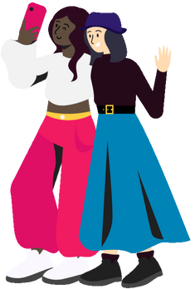
SUPPORT BUBBLES
friends
teachers and school staff
Pets
family

