Slide 2
Self harm
Relationships
Strong
Emotions
Anxiety
Exam stress
Low mood
Transition

Slide 3
What young people talk about..
'''I feel like I can't be myself around my friends, I feel like I don't fit in ''
'''Sometimes I feel alone, I want to
make new friends
but I don't know how to''
'''I feel pressured into doing things when I am out with my friends but I can't say no ''
'' I am dating someone who wants to spend lots of time with me but I want
to see my friends and family too''
'''I get nasty comments online all the time about the way I look but I don't want to come off social media ''

Slide 4
Healthy Relationships
Forgiveness
Respect
Compromise
Support
Trust
Listening
Boundaries
Apologising

Slide 5
Unhealthy relationships
Not feeling supported
Rumours
Jealousy
Feeling bad about yourself
Can't be
yourself
Feeling
left out
Arguing frequently
Peer pressure
Controlling

Slide 6
Imagine you are holding a glass of water.
If you hold the water out in front of you for 1 minute, it is not a problem.
If you hold it out in front of you for 1 hour, you will have an ache in your arm.
If you hold it for 1 whole day, your arm will feel very numb and sore.
The weight of the glass of water does not change, but the longer you hold it the heavier it becomes

Slide 7
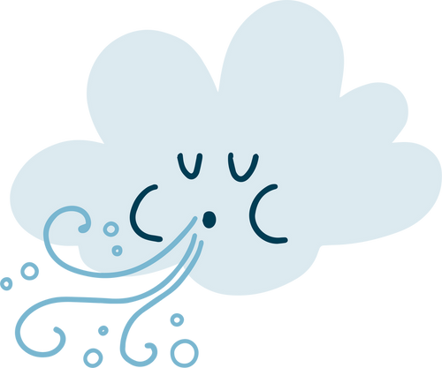
The stresses and worries related to peer groups and friendships are like that glass of water, the longer you hold your worries in the more it will affect your body.
We are here to help you blow away the storms

Slide 8
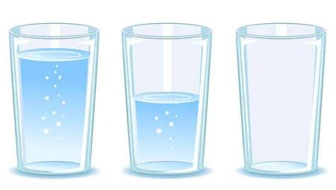
Some people are fighting battles you know nothing about.
Friend A
Friend B
Friend C

