Slide 2
What is the difference between bullying and cyberbullying?

Slide 3
Bullying
Bullying is behaviour that hurts someone else. It includes name calling, hitting, pushing, spreading rumors, threatening or undermining someone.
It can happen anywhere – at school, at home. It's usually repeated over a long period of time and can hurt a person both physically and emotionally

Slide 4
Cyber-Bullying
Cyberbullying is any form of bullying which takes place online. This can be done over smartphones, tablets, online gaming, chat forums, social and other media.

Slide 5
Young people who experience bullying need to be supported effectively and it's really important that they feel that their concerns are taken seriously.
However, it's also vital to ensure that those displaying bullying behaviour are challenged and supported appropriately where required.

Slide 6
Imagine you are holding a glass of water.
If you hold the water out in front of you for 1 minute, it is not a problem.
If you hold it out in front of you for 1 hour, you will have an ache in your arm.
If you hold it for 1 whole day, your arm will feel very numb and sore.
The weight of the glass of water does not change, but the longer you hold it the heavier it becomes

Slide 7
The feelings and worries related to bullying and cyberbullying are like that glass of water, the longer you hold your negative feelings the more it will affect your body.
We are here to help you blow away the storms

Slide 8
What effect can bullying & cyberbullying have on your mental health?

Slide 9
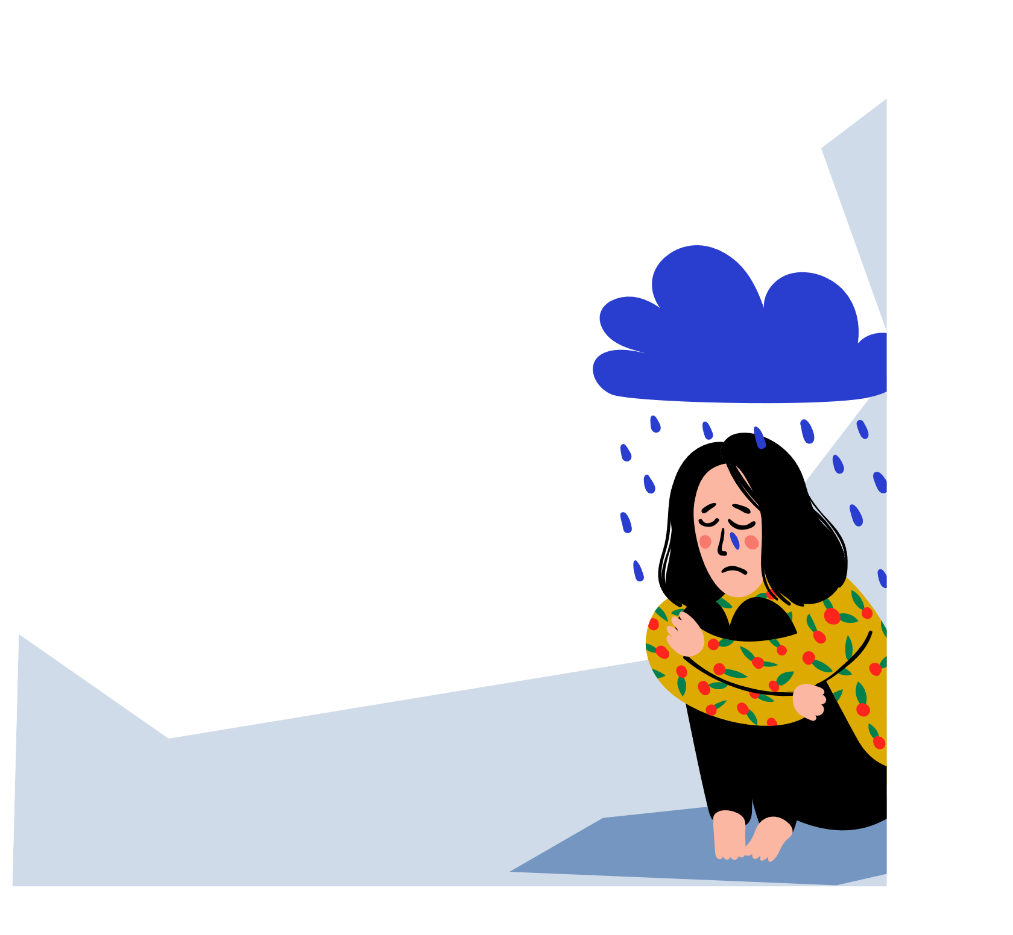
The effects of Bullying & Cyberbullying
Unhealthy relationships can have long-lasting effects on children and young people it can lead to:
Anxiety
Panic attacks Self-harm
Eating disorders Suicidal thoughts Becoming withdrawn Low Self-Esteem

Slide 10
Am I part of
the bullying?
If you use digital technology to upset, anger or embarrass someone on purpose, this means you’re involved in online bullying. It might be as simple as ‘liking’ a mean post on Facebook or spreading a rumour on snapchat. The person being bullied could feel like you’re part of the bullying. It’s important to think about how we might feel if someone said the same thing about us.

Slide 11
Helping a friend that is experiencing bullying/cyber bullying..
Things you can try to help a friend who is being bullied:
Listen to them - it can be really helpful for them to have someone to talk things through with.
Support your friend - offering to go with them toreport the bullying and help them think about what they want to say.
Give them a compliment - this may help them feel likethey aren’t so alone when other people are posting negative messages.
Do things together - this may help to take their mind off things for a short while. You could watch a DVD, play sports or go to the cinema.

Slide 12
How does your school currently support bullying/cyber bullying..

Slide 13
Top tips to tackle bullying and cyber bullying..
All forms of offensive or discriminatory language should be challenged (eg homophobic and transphobic comments, sexist and sexual language, racist and faith targeted comments.
Remind the victim that it is not their fault
they are being bullied. They should never change who they are or be asked to ignore it.
Ask young people about
what it feels like to be in your school, whether there are any bullying hot spots – and if there is anything you could do differently to stop
bullying

Slide 14
Top tips to tackle bullying and cyber bullying..
The only way to stop
bullying is to acknowledge that it happens and create a talking culture in your school where any hurtful behaviour is quickly brought out in the open, discussed and dealt with.
All young people should be supported to speak out if they or someone they know is being bullied. Designated areas where pupils can report bullying

Slide 15
We tackle bullying in schools by...
Reporting
Listening
Including all
Celebrating differences
Believing

Slide 16
We tackle bullying in schools by
Understanding
Respecting
Taking action
Challenging

Slide 17
Who else can support you?
If you think you might have an unhealthy friendship or relationship, trust your instincts and speak to an adult you trust about how you’re feeling. If this is difficult for you, you could write it down or visit one of the website below for further help.

