Slide 9
Voice of the child…

Slide 10
What do we already do to promote RSHE in Early Years?

Slide 11
What can we continue doing?

Slide 12
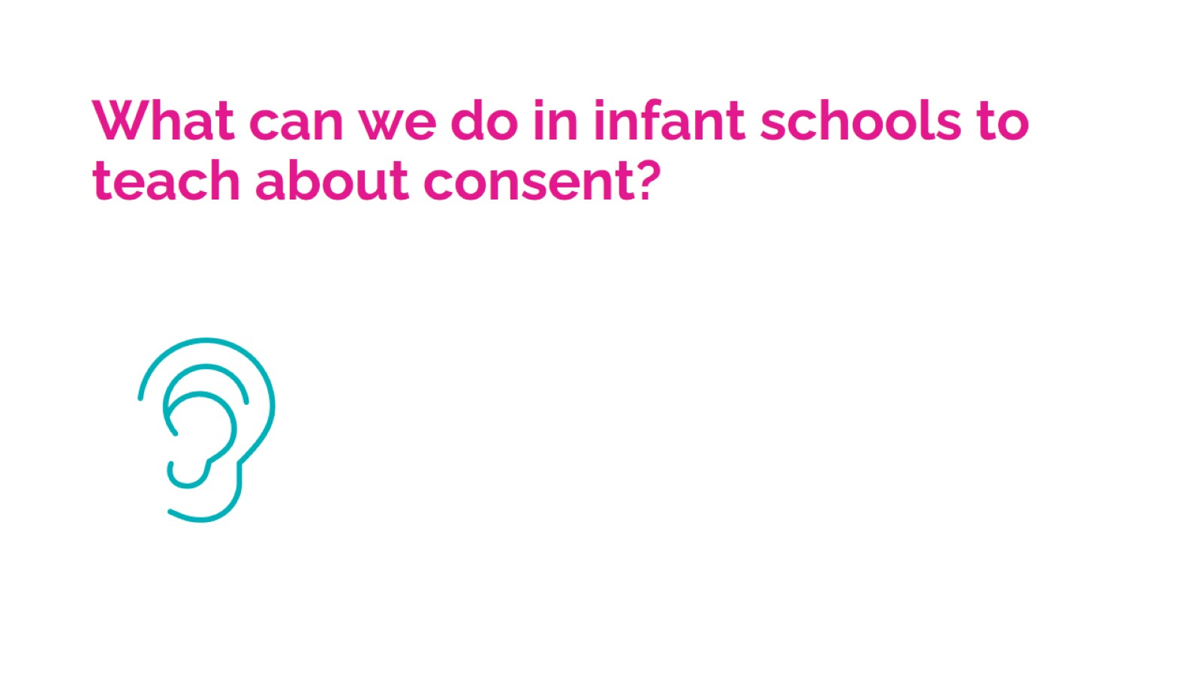
What can we do in infant schools to teach about consent?

Slide 19
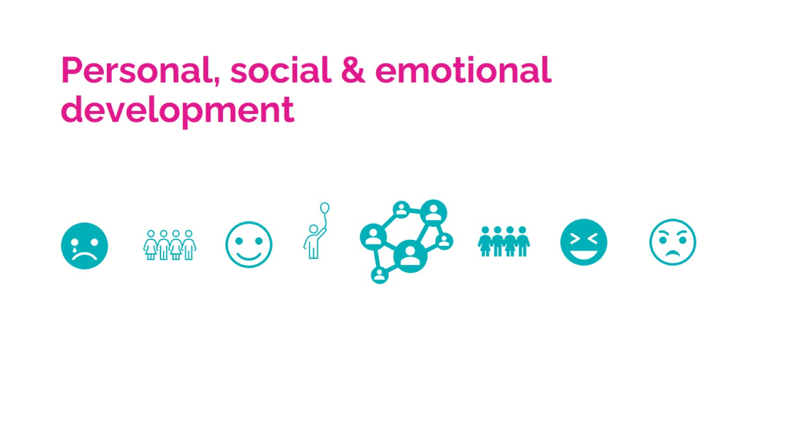
Personal, social & emotional development

Slide 20
Challenging language

Slide 30
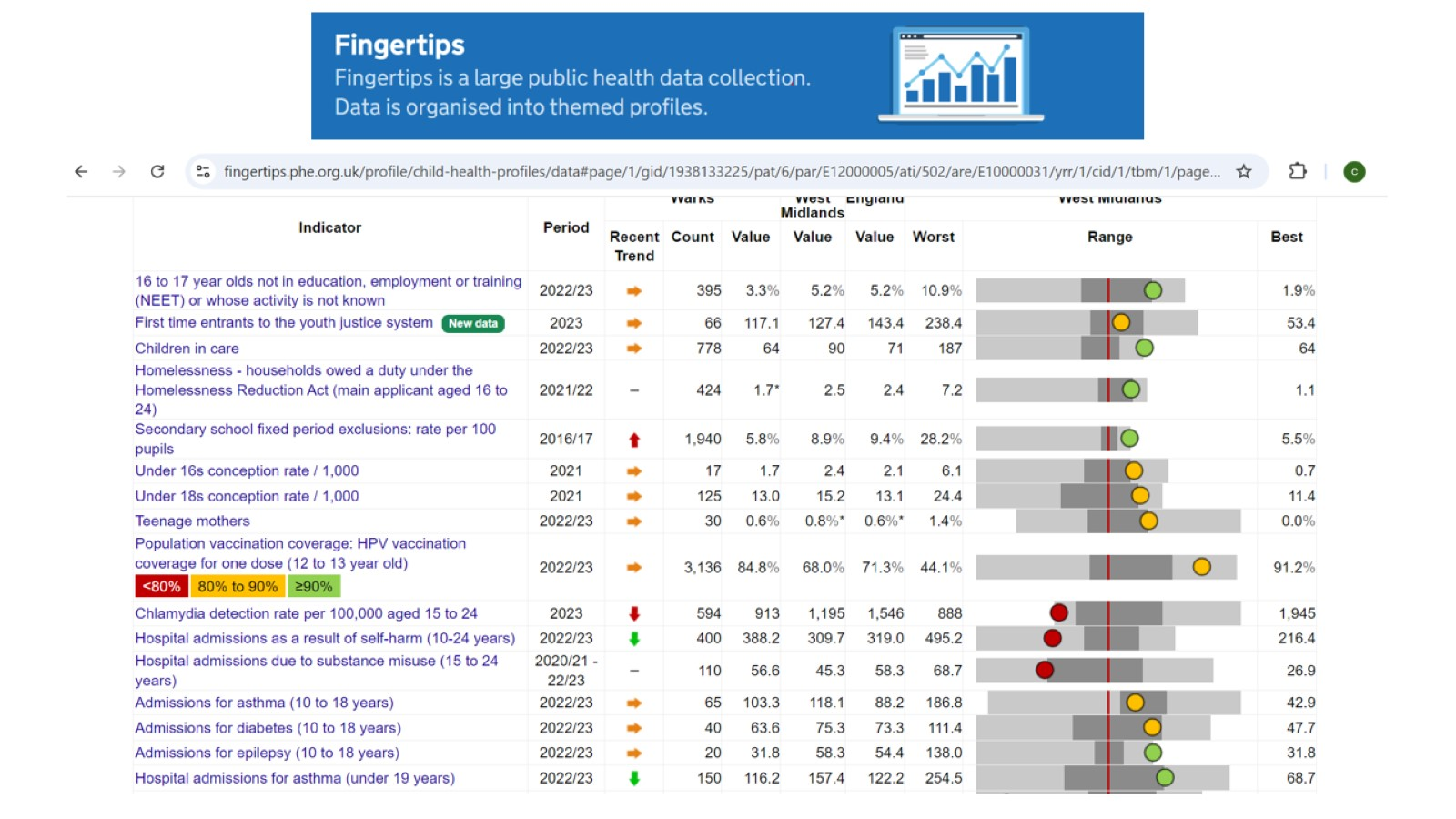

Slide 31
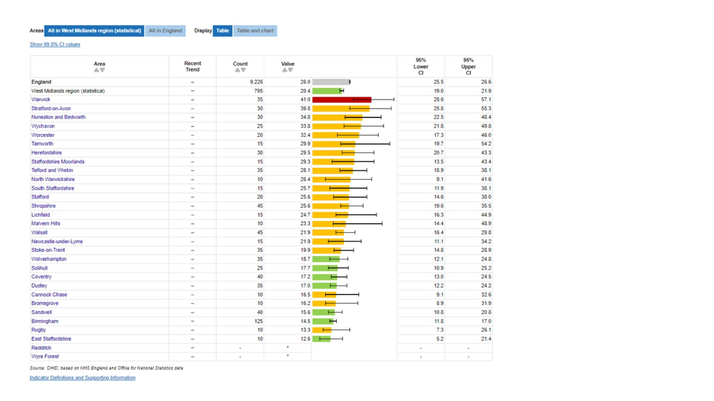

Slide 37
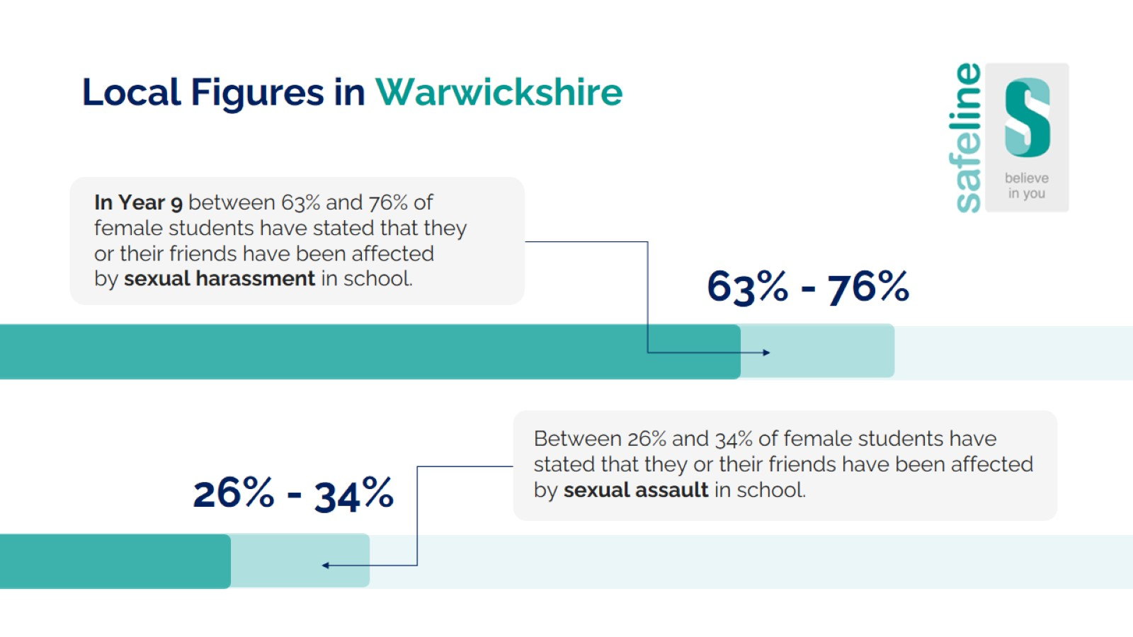

Slide 38
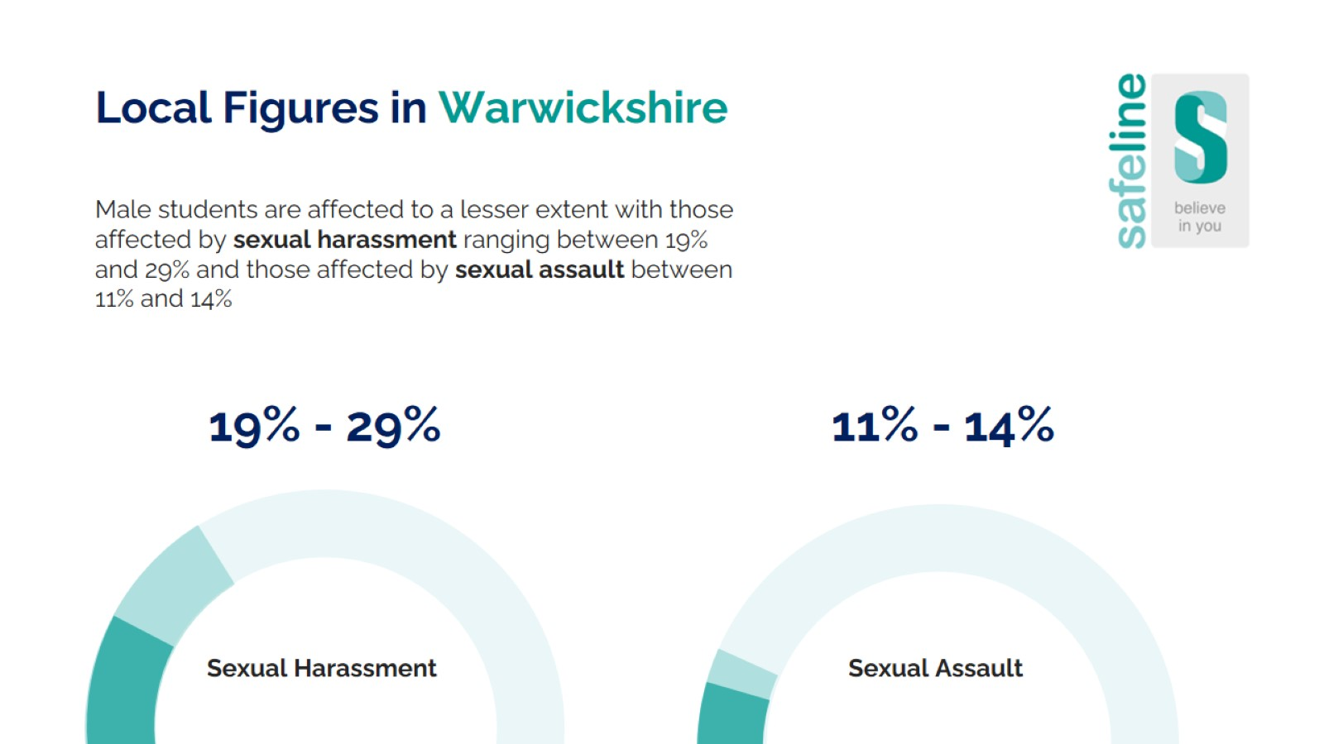

Slide 39
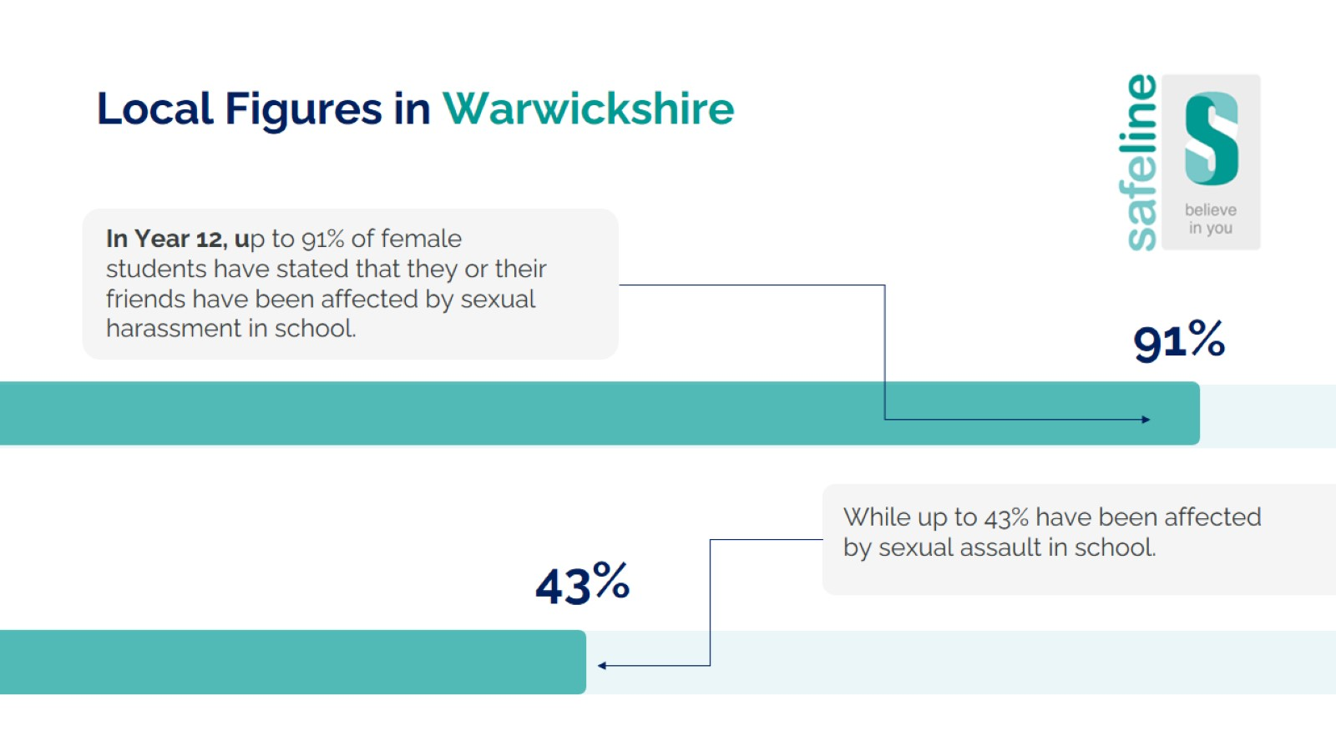

Slide 40
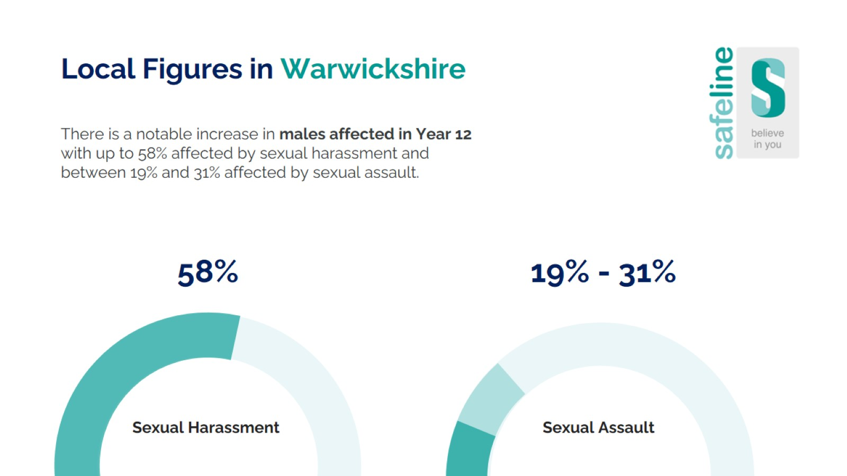

Slide 44
